Slide 1










Bee U
-The Game to fight against social Isolation
PICTIONARY
Couple
Family
MEMORY LANE
CLUB ACTIVITIES
Friends
Explorer

Slide 2
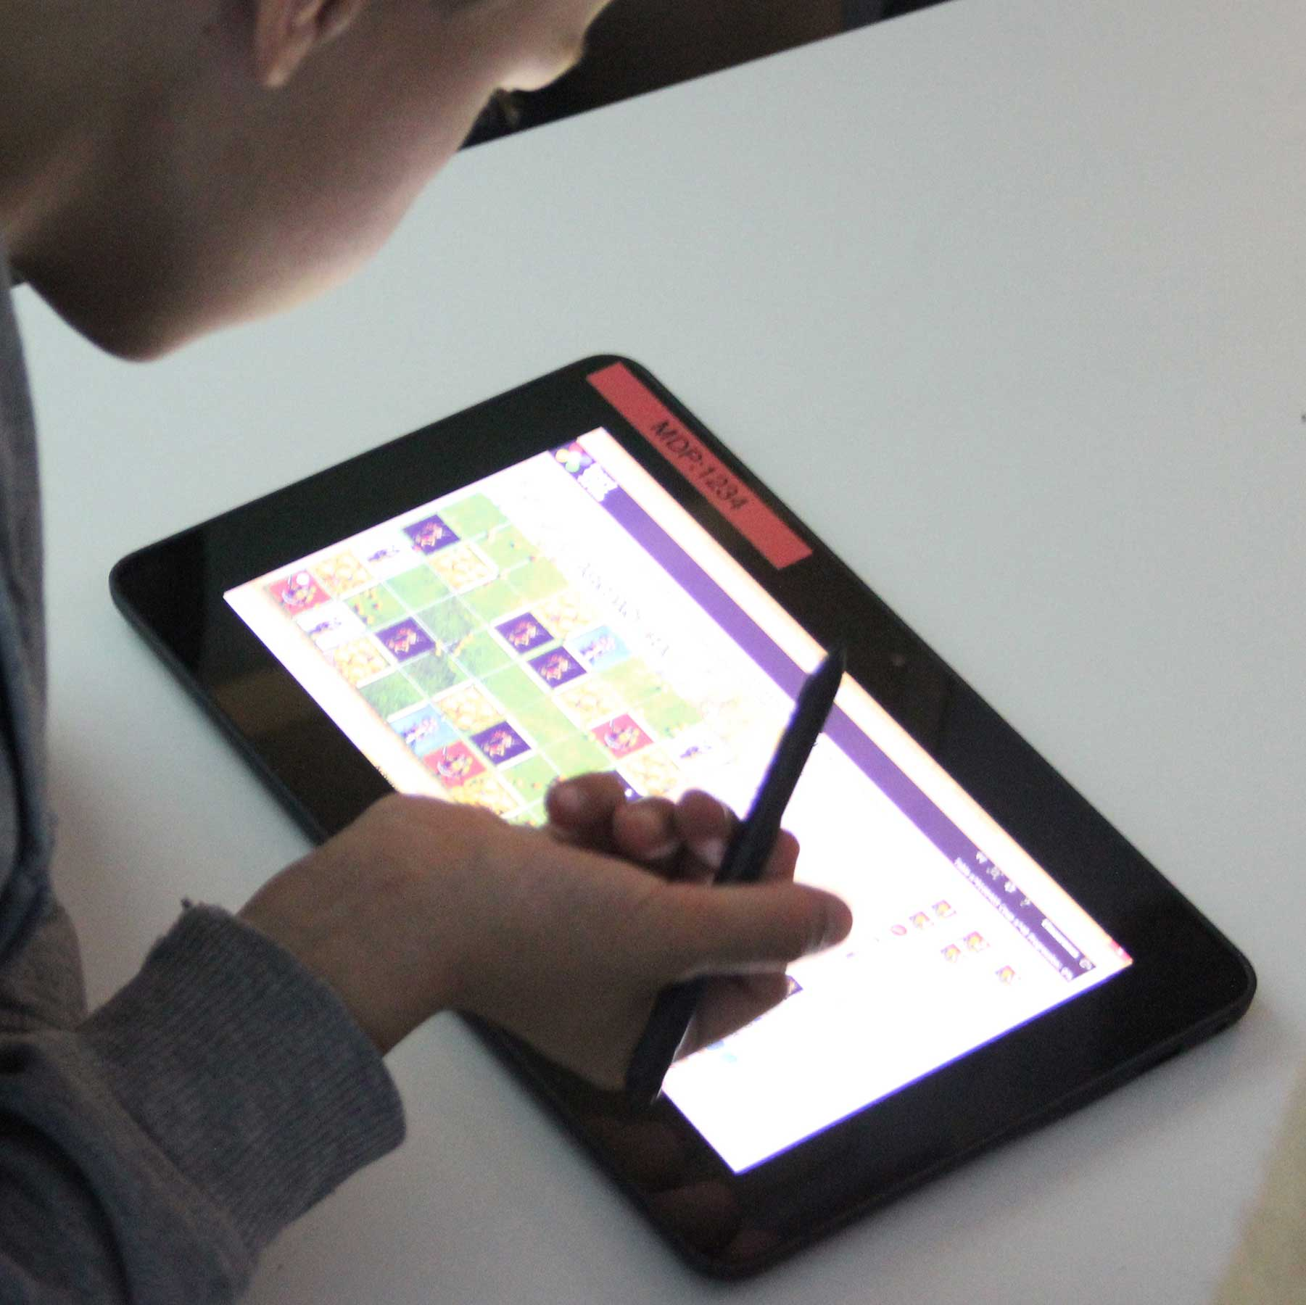



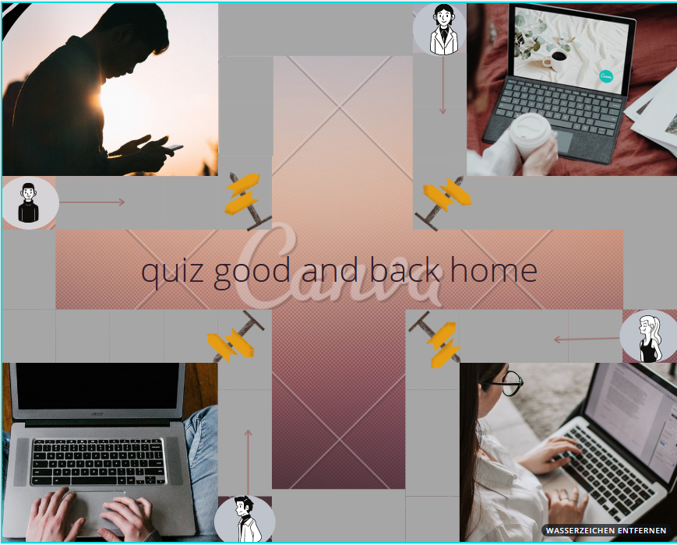

Serious Game Project
1. Quiz gut and back Home
Goals
answer the questions as quickly as possible to get home,
Feedback
When answering the system displays the gain/loss
Reward Systems score of all players, play again, quit, Speak.
Rules
wait his turn to answer a question.
Reply in the interval of time give
Respond faster to get the most points.
The more time passes, the points for the question decrease.
If a player's avatar meets me in road I go back to the starting box.
Write to a private person or to the whole group.

